Slide 1

APEX INSTITUTE OF TECHNOLOGY
DEPARTMENT OF COMPUTER SCIENCE & ENGINEERING
DEEP LEARNING (20CSF-432)
Faculty: Prof. (Dr.) Madan Lal Saini(E13485)
Lecture – 1
Introduction to Neural Network
DISCOVER . LEARN . EMPOWER

Slide 2
Deep Learning: Course Objectives
COURSE OBJECTIVES
The Course aims to:
Understand the key features in a neural network’s architecture
Understand the main fundamentals that drive Deep Learning
Be able to build, train and apply fully connected deep neural networks
Know how to implement efficient CNN or RNN.
Implementation the fundamental methods involved in deep learning, including the underlying optimization concepts (gradient descent and backpropagation) and how they can be combined to solve real-world problems.

Slide 3
COURSE OUTCOMES
On completion of this course, the students shall be able to:-
CO1 | Understand neural network, its working and parameters, and various deep neural network architectures.
CO2 | Differentiate between the major types of neural network architectures (multi-layered perceptron, convolutional neural networks, recurrent neural networks, etc.) and what types of problems can be solved by these architectures.
CO3 | Evaluate the performance of deep neural network and improve the performance by applying optimization techniques.
CO4 | Design or select neural network architectures for new data problems based on their requirements and problem characteristics and analyse their performance.
CO5 | Describe some of the latest research being conducted in the field and open problems that are yet to be solved.

Slide 4
Unit-1 Syllabus
Unit-1 | Artificial Neural Network
Fundamentals of Neural Network | Introduction to Neural Network, Model of Artificial Neuron, Multilayer Perceptron, Back Propagation, Learning rules and various activation functions, Gradient descent, Stochastic Gradient descent.
Neural Network Architecture | Single layer Feed-forward networks. Multi-layer Feed-forward networks. Architecture of Back-propagation (BP) Networks, Backpropagation Learning.
Training Neural Network | Training Deep Neural Networks using Back Propagation-Setup and initialization issues, Gradient- Descent Strategies, vanishing and exploding Gradient problems, regularizations, and dropouts.

Slide 5
SUGGESTIVE READINGS
TEXT BOOKS:
T1: Deep Learning with Python by Francois Chollet, Publisher: Manning Publications
T2: Deep Learning from Scratch: Building with Python from First Principles by Seth Weidman published by O`Reilley
T3: Deep Learning by Ian Goodfellow, Yoshua Bengio and Aaron Courville published by MIT Press.
REFERENCE BOOKS:
R1 Fundamentals of Deep Learning: by Nithin Buduma, Nikhil Buduma and Joe Papa, OREILLY Publication, Second Edition.
R2 Deep Learning: A Practitioners Approach by Josh Patterson and Adam Gibson, OREILLY Publication.
R3 Deep Learning for Coders with fastai and PyTorch by Jeremy Howard and Sylvain Gugger, OREILLY Publication.
R4 Deep Learning Using Python by S Lovelyn Rose, L Ashok Kumar, D Karthika Renuka, Wiley Publication

Slide 6
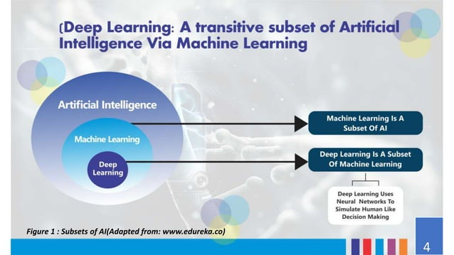

Slide 7
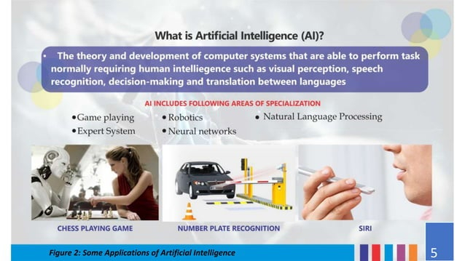

Slide 8
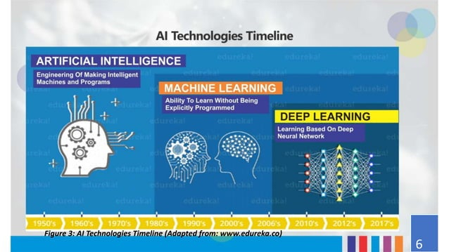

Slide 9
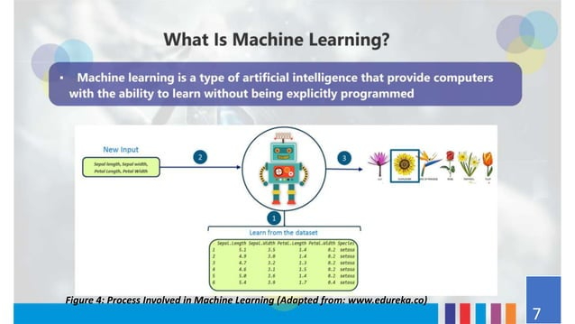

Slide 10
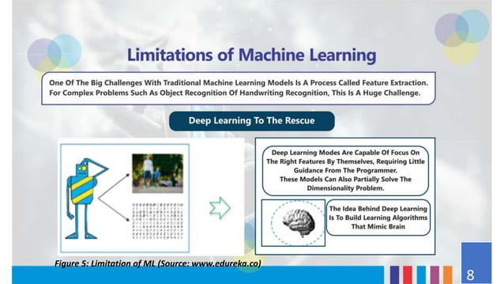

Slide 11
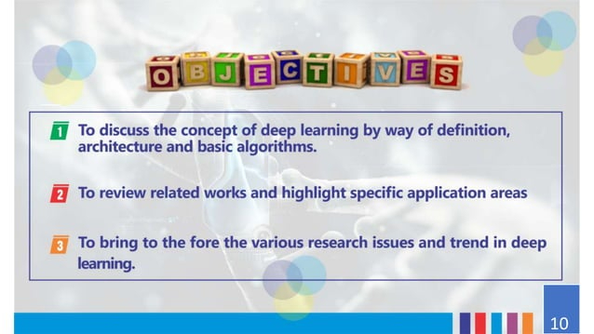

Slide 12
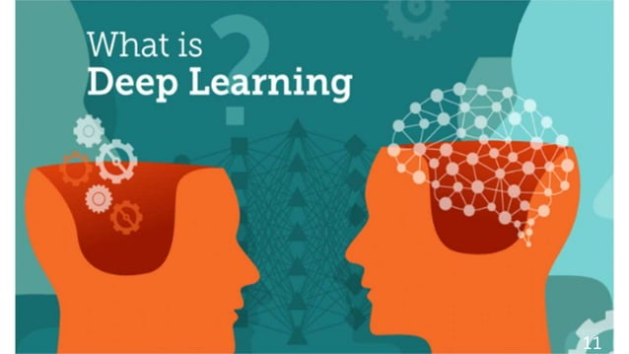

Slide 13
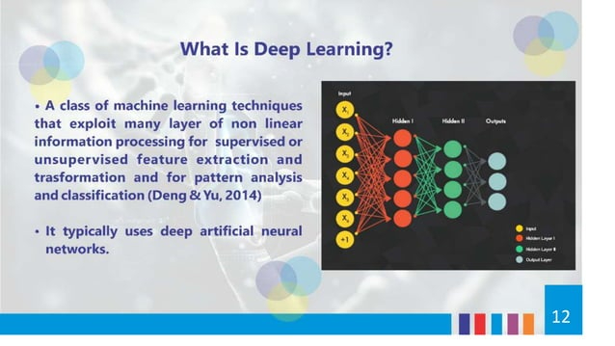

Slide 14
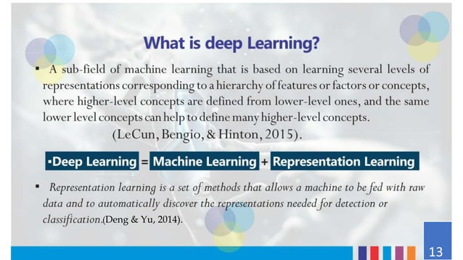

Slide 15
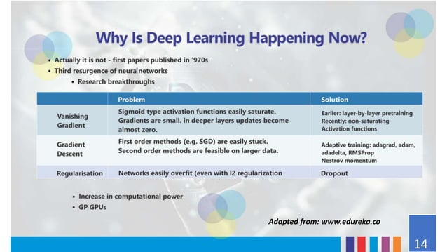

Slide 16
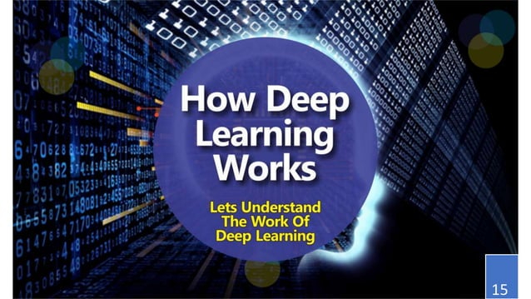

Slide 17
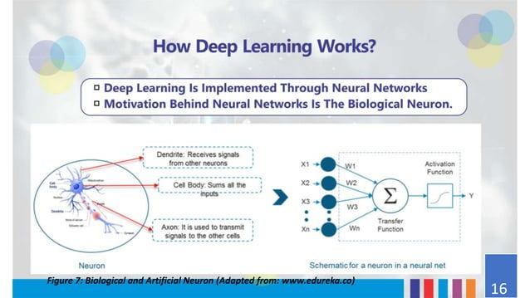

Slide 18
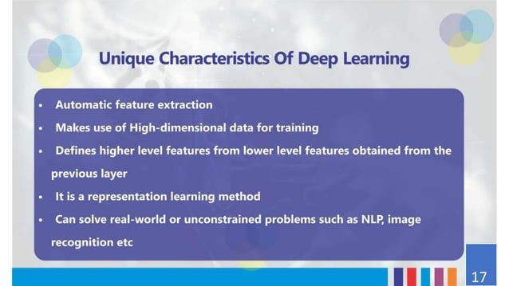

Slide 19
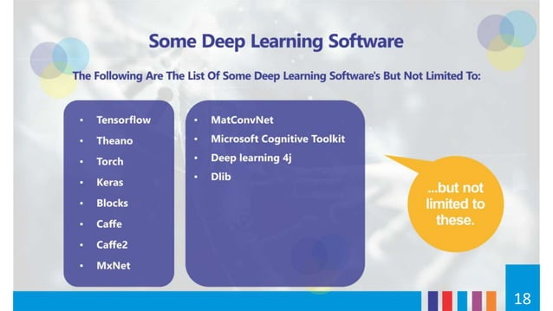

Slide 20
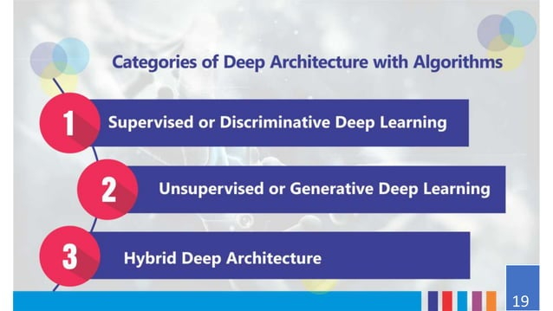

Slide 21
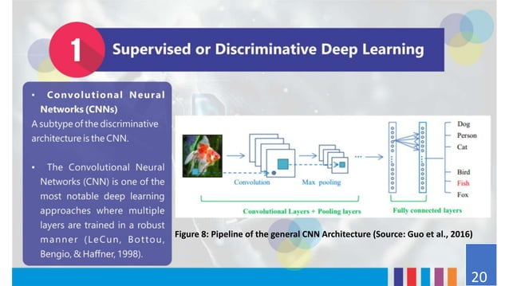

Slide 22
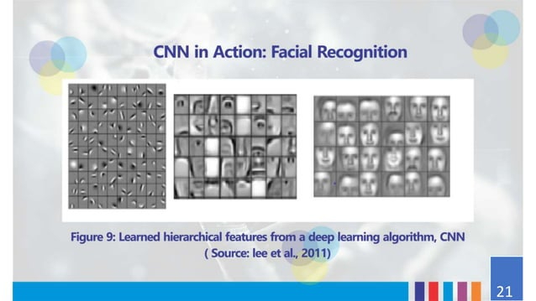

Slide 23
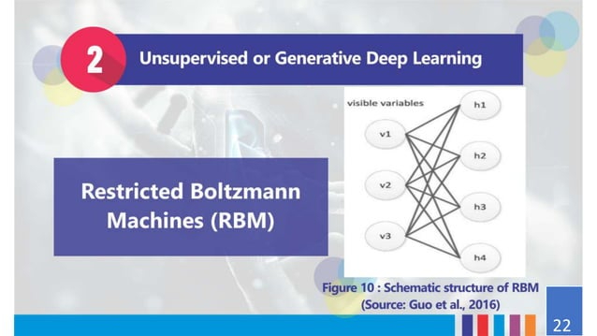

Slide 24
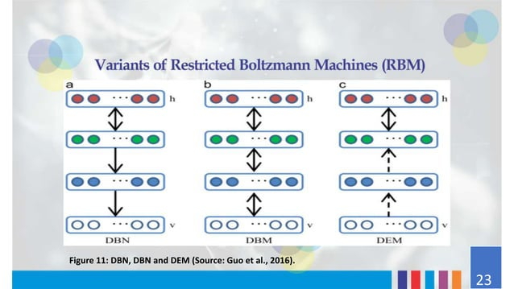

Slide 25
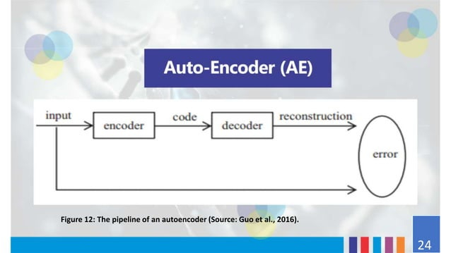

Slide 26
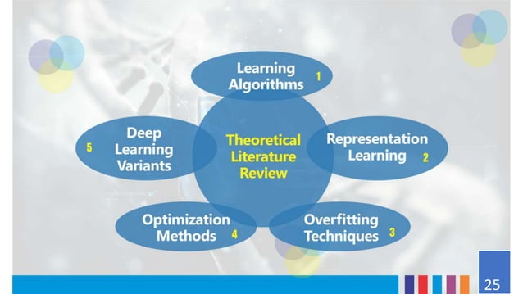

Slide 27
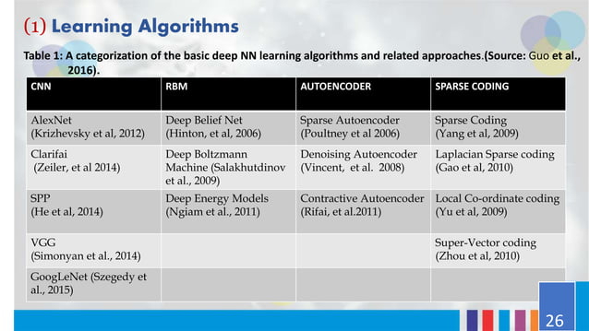

Slide 28
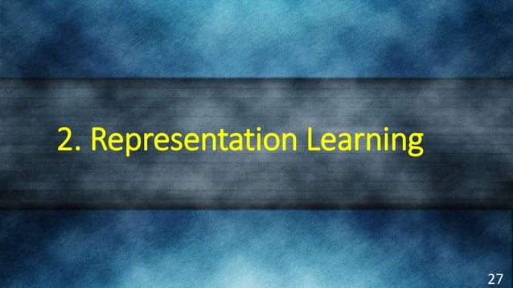

Slide 29
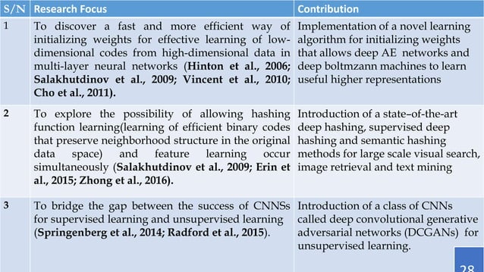

Slide 30
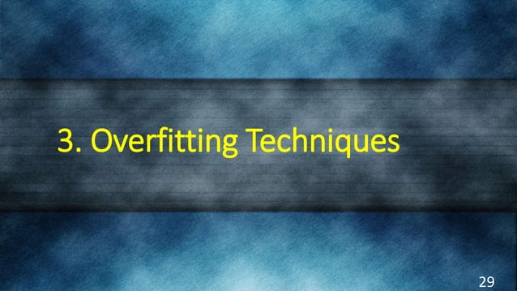

Slide 31
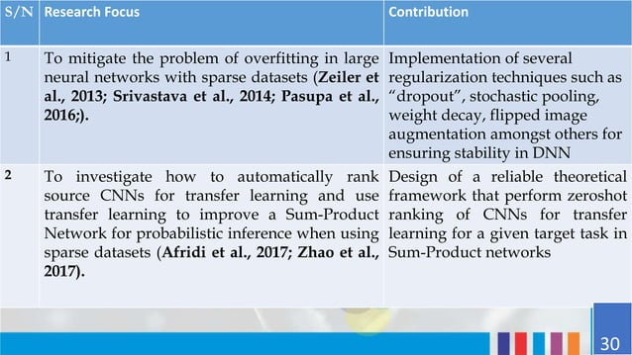

Slide 32


Slide 33
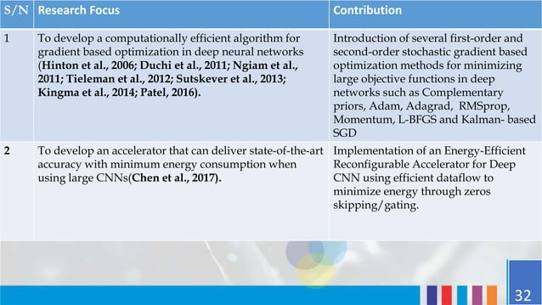

Slide 34
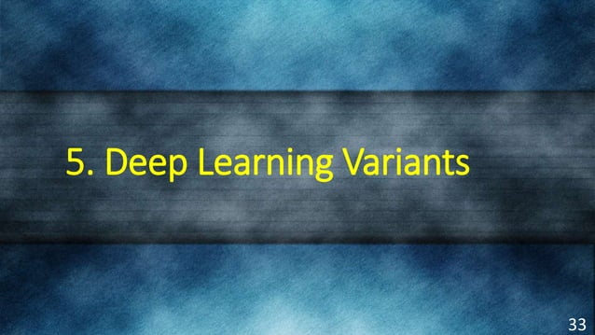

Slide 35
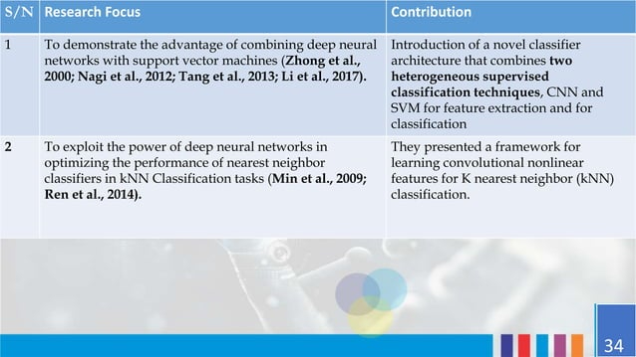

Slide 36
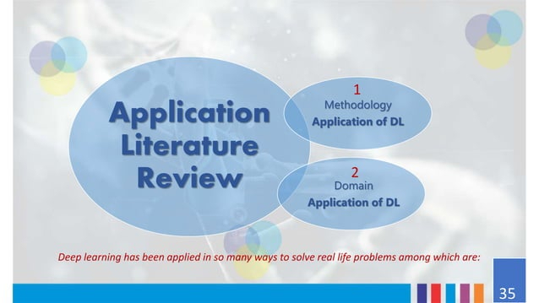

Slide 37
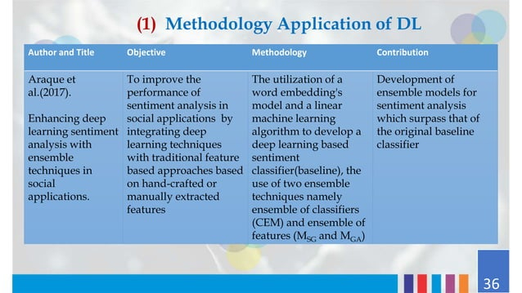

Slide 38
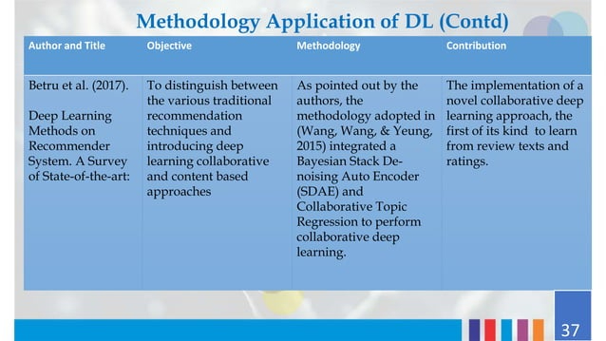

Slide 39
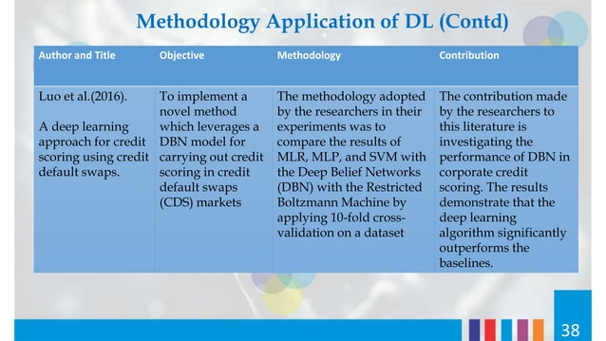

Slide 40
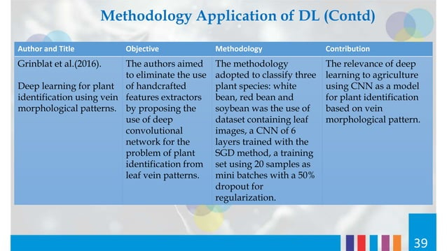

Slide 41
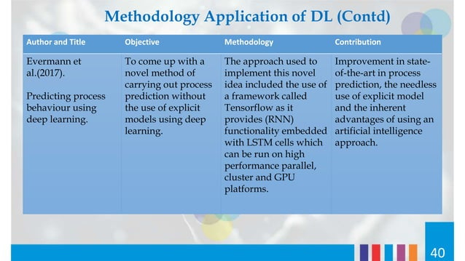

Slide 42
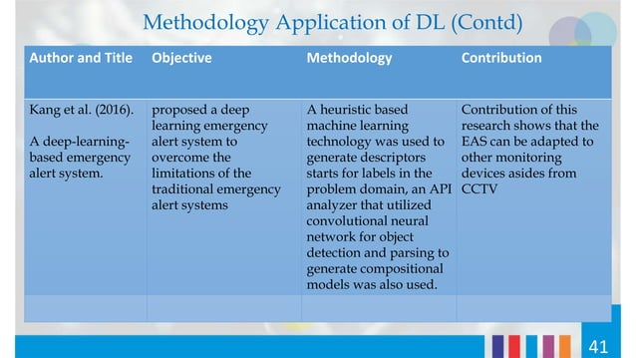

Slide 43
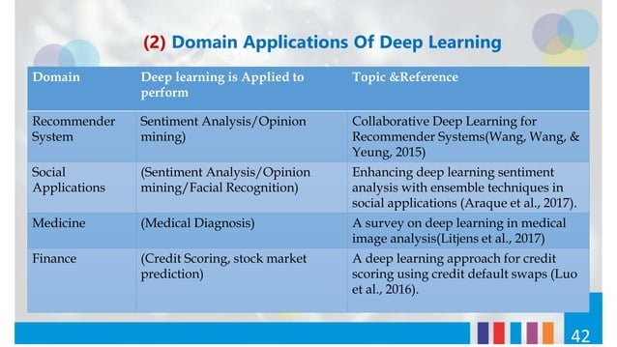

Slide 44
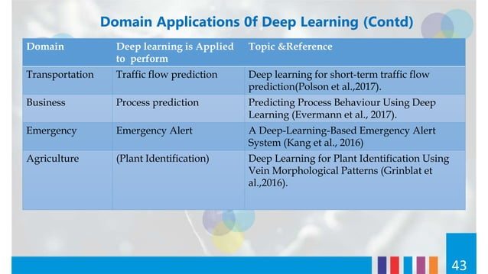

Slide 45
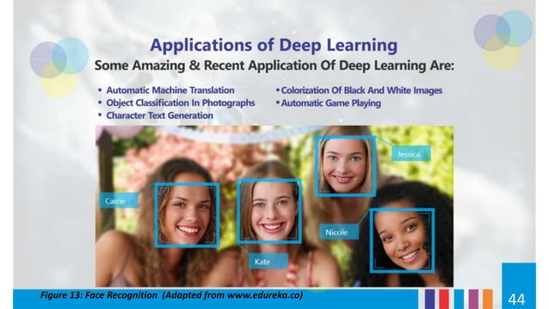

Slide 46
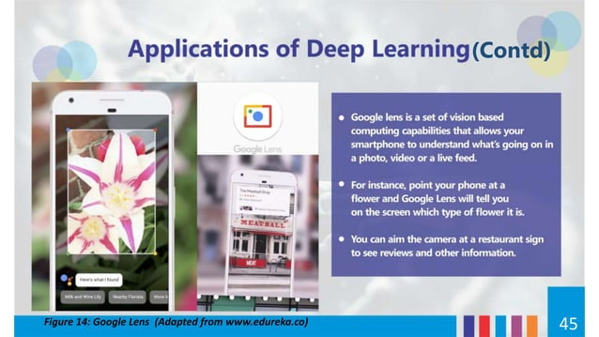

Slide 47
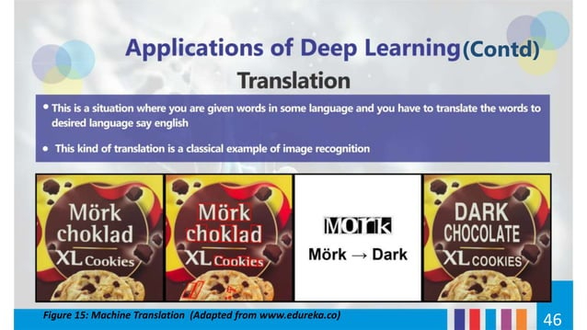

Slide 48


Slide 49
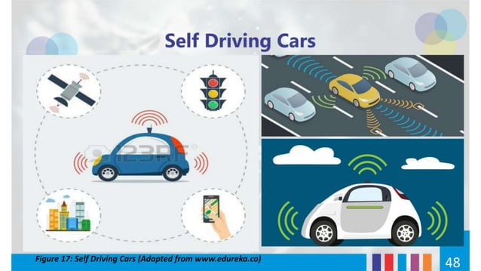

Slide 50
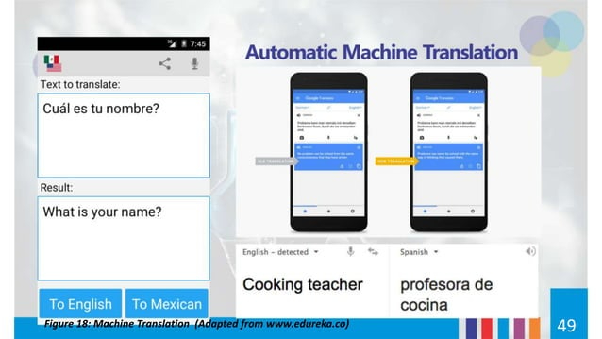

Slide 51
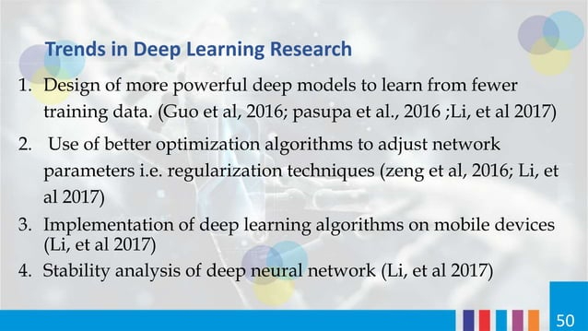

Slide 52
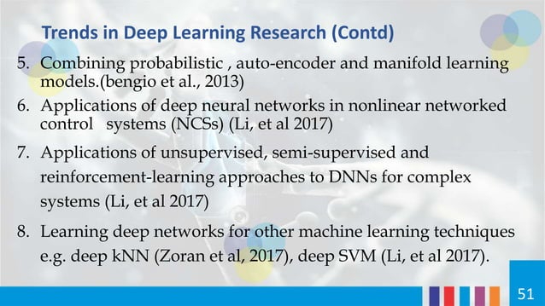

Slide 53
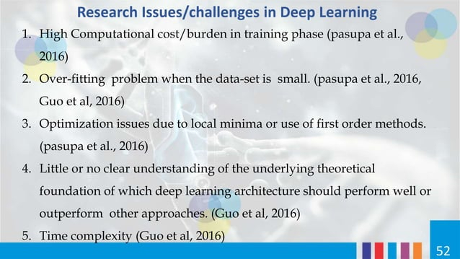

Slide 54
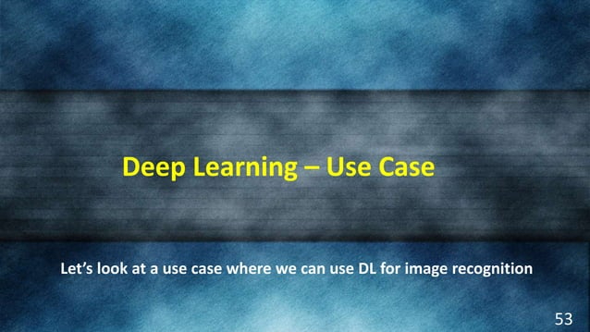

Slide 55
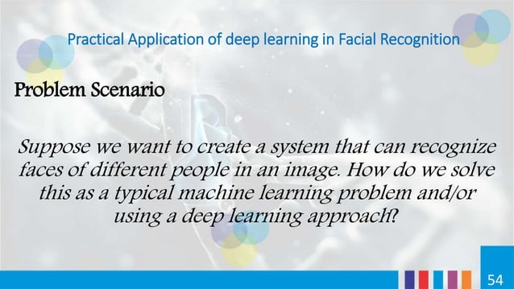

Slide 56
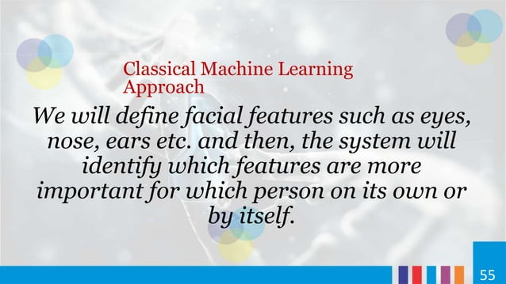

Slide 57
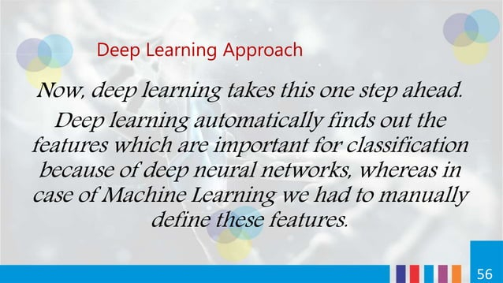

Slide 58


Slide 59


Slide 60


Slide 61


Slide 62


Slide 63


Slide 64


Slide 65


Slide 66


Slide 67


Slide 68


Slide 69


Slide 70


Slide 71


Slide 72


Slide 73


Slide 74


Slide 75


Slide 76


Slide 77


Slide 78


Slide 79
Questions?
1. Where the multilayer perceptron model is used?
2. Where the recurrent neural networks are used?

Slide 80
References
Book:
Deep Learning with Python, Authors: Francois Chollet, Publisher: Manning Publications.
Deep Learning Using Python, Authors: S Lovelyn Rose, L Ashok Kumar, D Karthika Renuka, Publisher: Wiley Publication.
Websites:
https://www.analyticsvidhya.com/blog/2022/01/introduction-to-neural-networks/
https://towardsdatascience.com/the-basics-of-neural-networks-neural-network-series-part-1-4419e343b2b
https://www.tutorialspoint.com/artificial_neural_network/artificial_neural_network_basic_concepts.htm
NPTEL
https://www.youtube.com/watch?v=4TC5s_xNKSs/

Slide 81
THANK YOU
For queries
Email: madan.e13485@cumail.in

